Slide 1
Shore Sweep Option 1
A new app for Android and IOS
(no desktop admin)

Slide 2
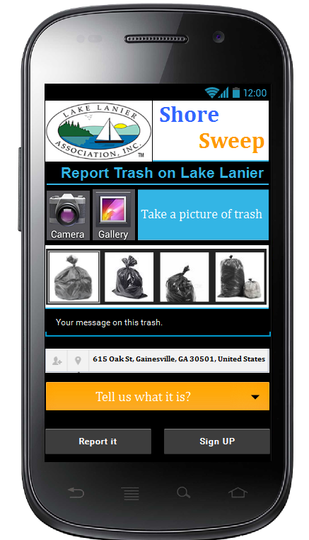
Home Screen
Any user wants to report trash
0101. User starts the process of reporting an item by taking a photo
Picture appears, below the camera icon
0201. Location defaults to current GPS coordinates. (or GPS location on Image Meta) User can tap on map icon to adjust map to pinpoint location of item. When user taps “tap here to view map” This will launch Update Location Screen
0301. Under “tell us what it is” User selects from a predetermined list of categories (hardcoded for now, set by admin in the future)
0401. When user taps “Report it” the data is saved and a confirmation screen is next
0501. Only Admin can sign in via sign in button or some other method
0601. When user taps on blue area labeled “take a picture of trash” or on the camera icon, the devices camera will open
Tap here to view Map

Slide 3
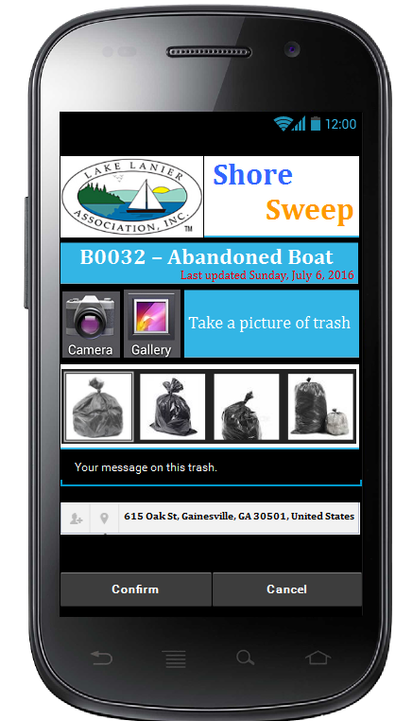
Confirmation Screen
0701. Unique ID of the item (System generated)
First 2 letters of ID number represents the item type
AB- Abandoned Boat
ST- Small Trash
SF-Small Float
Etc..
0801. Picture taken by user can be full screen when tapped
0901. User can add new photos of item by tapping one of the icons (or the blue area labeled “take a picture of trash”)
1001. User can tap on the location to view or change the location of the item. User will be redirected to the update location screen. Text below address should state “tap here to view map” This will open Update Location Screen
1201. User can add a comment
1301. User can confirm or cancel report
A
Tap here to view Map

Slide 4
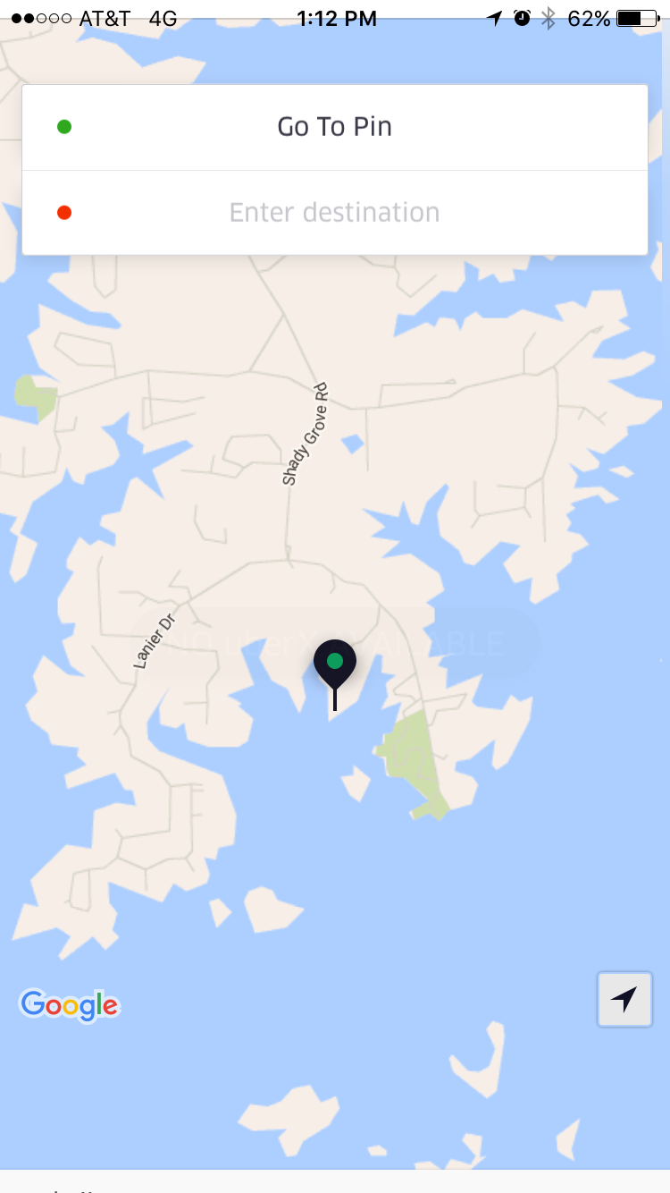
Update Location Screen
Pinch, Zoom, and move to locate PIN exactly on the spot where the object is
User can change the location of the item by pinching, zooming, or swiping to move the map. The pin will stay centered on the screen (similar to the way UBER works to set pickup location)
1510. User can tap the compass icon to re-center the map on their current location
1601. Upon update, change location and redirect to confirmation screen
1701. Upon cancel, do not change location and redirect to confirmation screen
Update
Cancel

Slide 5
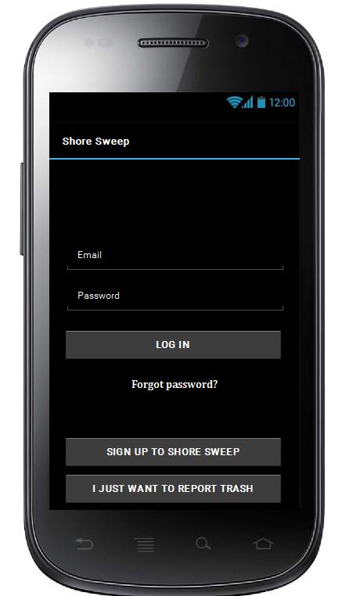
Login Screen
1801. if admin user is returning from same phone, email and masked password will be prepopulated.
1851: Once logged in, admin can enter a record ID and be directed to the update screen for that record
Enter Record # to view an existing record
View

Slide 6
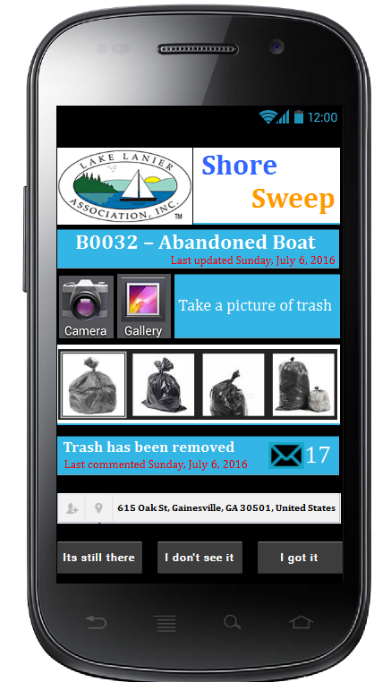
Update Record Screen
3601. Location defaults to current GPS coordinates. User can tap on map icon or text to adjust map to pinpoint location of item. This will launch Update Location Screen
3701. When user taps on blue area labeled “take a picture of trash” or on the camera icon, the devices camera will open
3801. Admin can add a comment by tapping on message window, By-default last comment from any user will be displayed. Screen on the next slide for add a new comment.
3901. Admin can change the state to “removed” by tapping either “I don’t see it”, or “I got it”
4001. Admin can change the state to “Verified” by tapping “Its still there”
Tap here to view Map

Slide 7
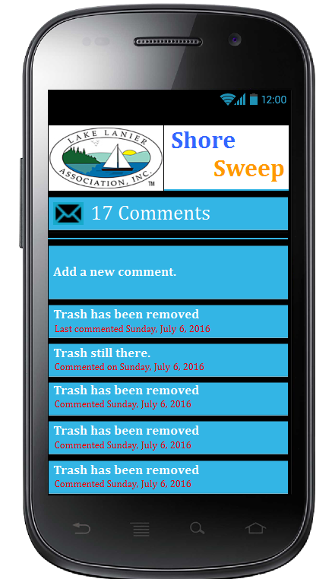
Adding a new comment to trash
4101. Admin can view all his/her comments OR Add a new comment to the assigned record.

Slide 8
Export
5901. Admin can have access to a current export of all records in csv format. Export can include last comment, but not pictures to keep the #of fields consistent for each record. (no preference on HOW the export can be done)

